Slide 1
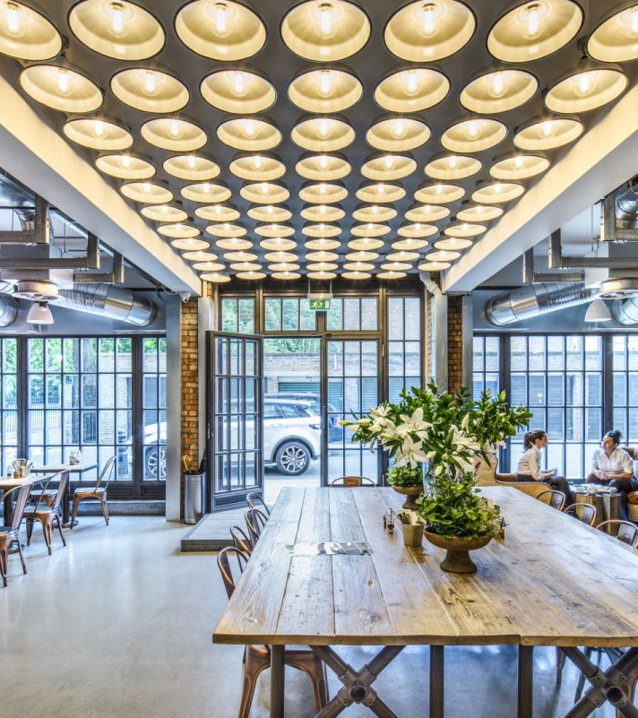

BBA 3rd SEM Session(2023-24) Business Model Development
Submitted To - Prachi Vasant
Submitted By - Shankh Bansal

Slide 2

Combination of traditional Indian flavours with healthier ingredients and preparation methods. Location – Ujjain, Free Ganj
About The Business

Slide 3
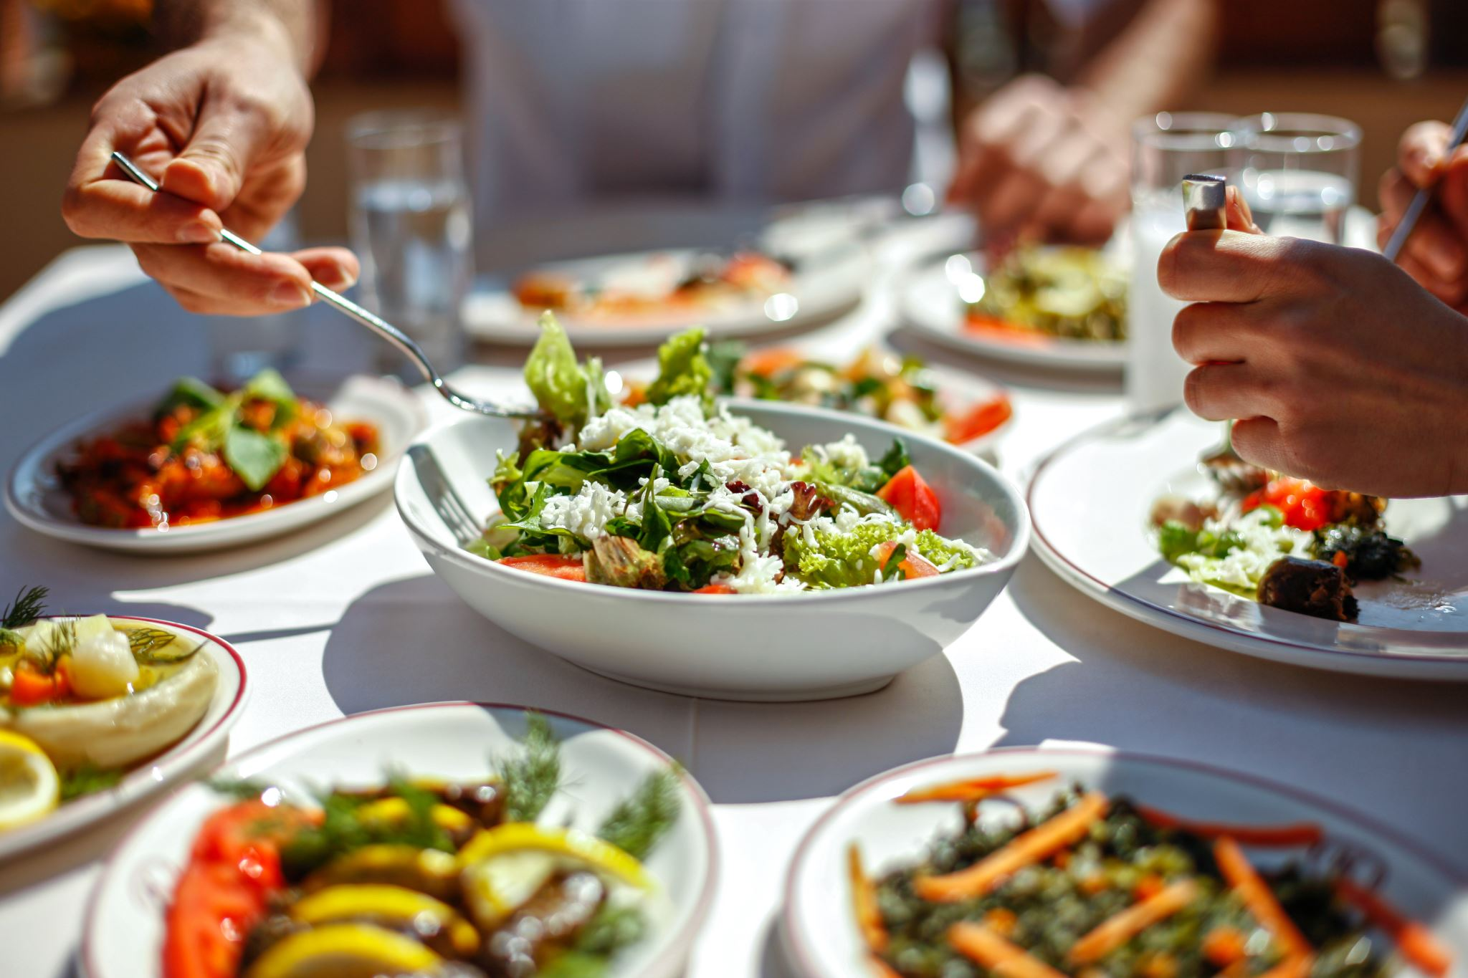
Mission
Our mission is to redefine the dining experience by offering fresh, wholesome, and delectable meals that nourish the body and delight the senses. We are committed to providing accessible, flavorful, and health-conscious menu options that support overall wellness. Our goal is to inspire a healthier lifestyle while ensuring exceptional taste and quality in every bite.

Slide 4
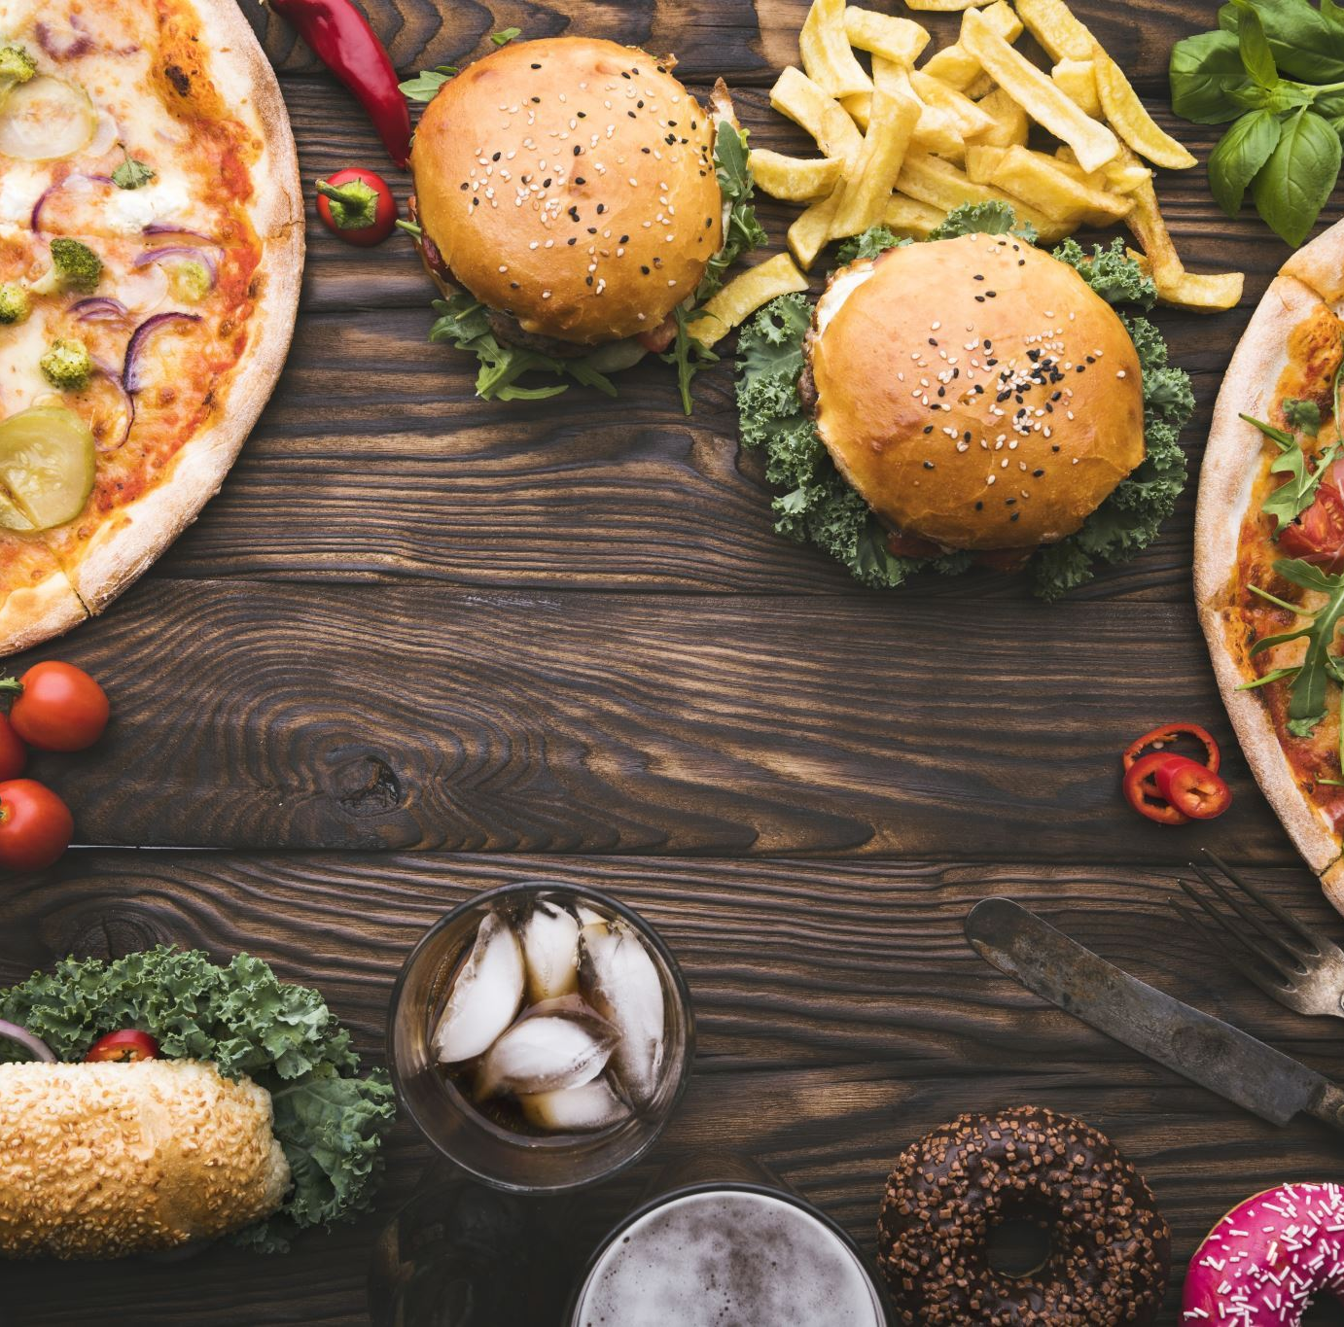
About The Business
We provide food with a Combination of traditional Indian flavours with healthier ingredients and preparation methods. Ex - Sweet Potato Fries with minty yoghurt dip.
We have a very unique spinning platform that will serve your food & that is insulated so that your food will not get soggy or cold.

Slide 5
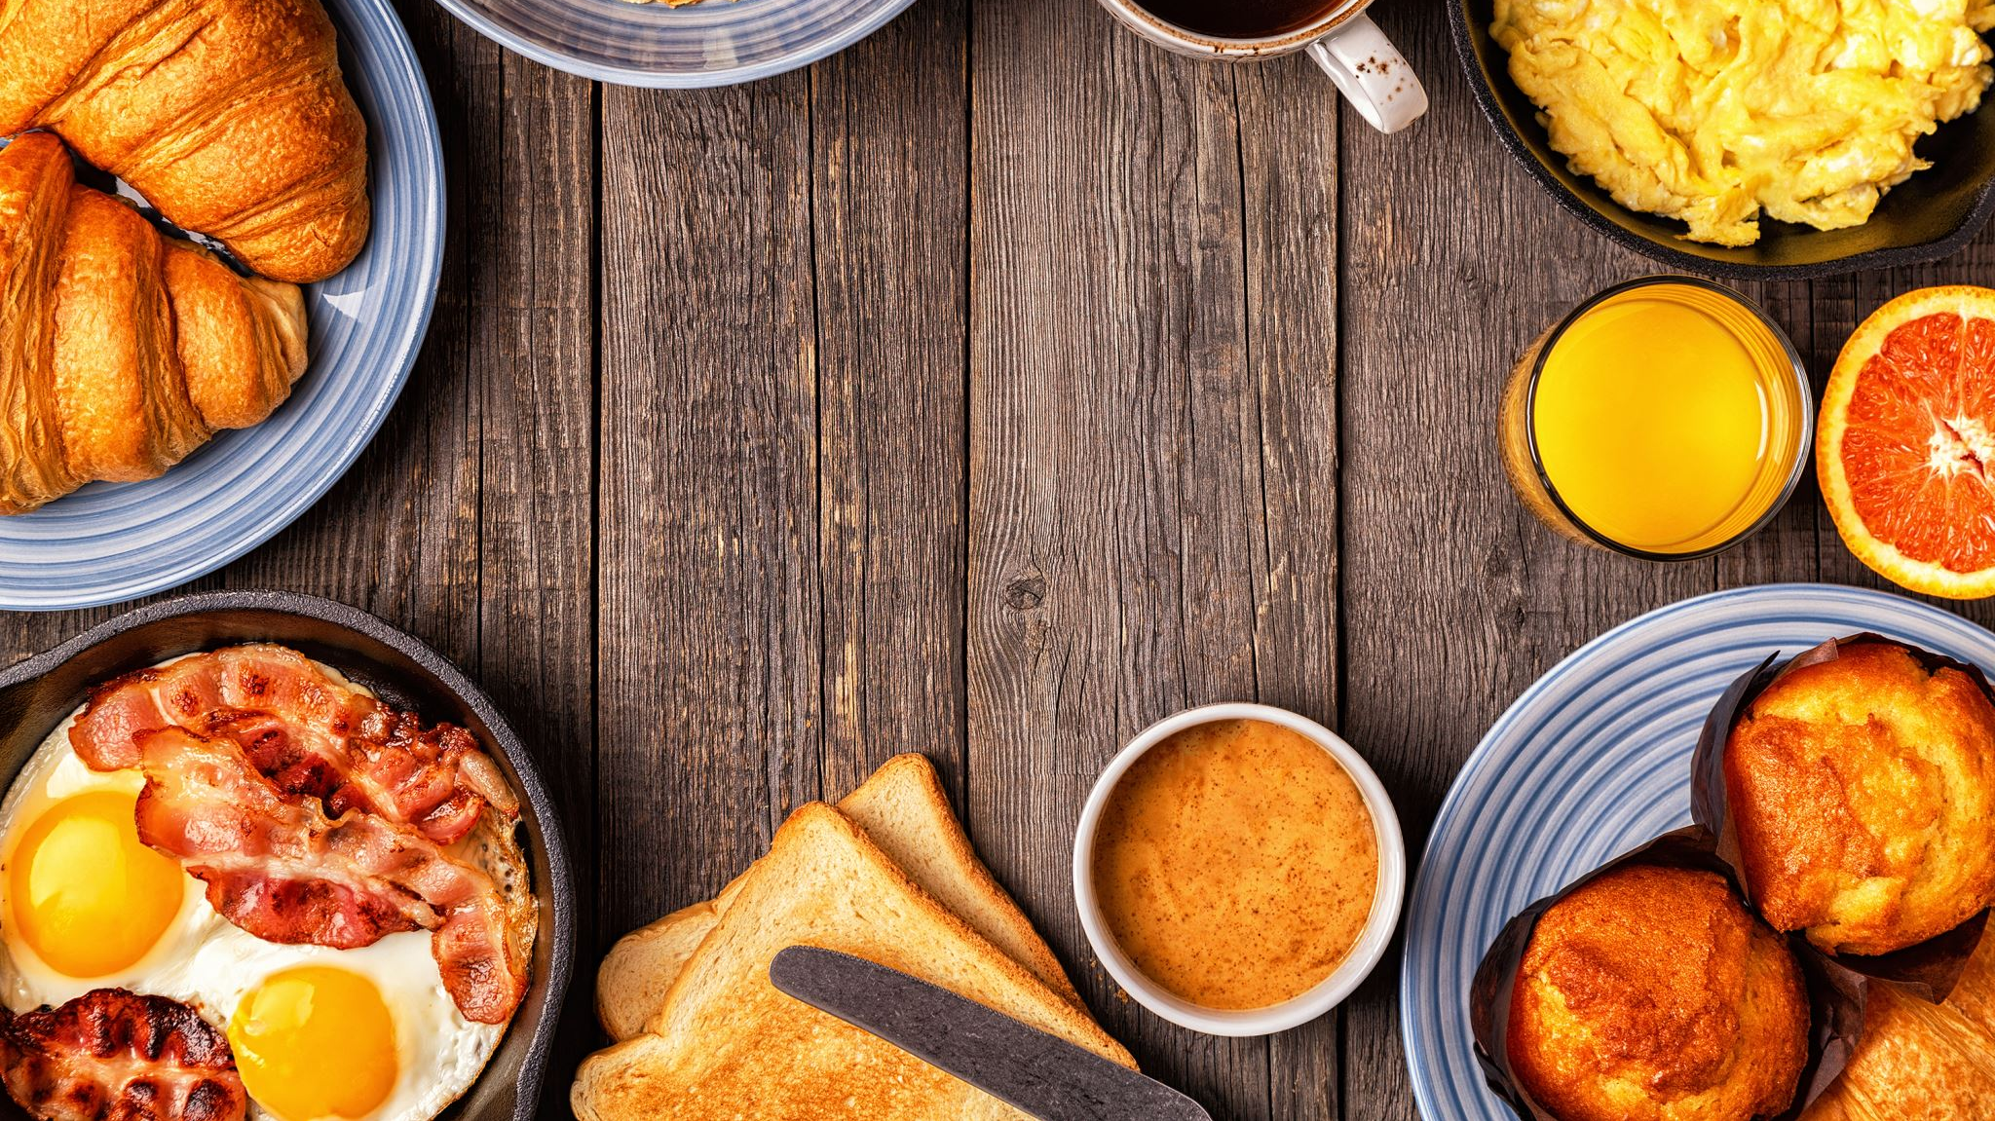
Factors to look upon before launching the Business

Slide 6
Market Research
Target Audience - Health-conscious individuals seeking nutritious, organic options. Athletes, fitness enthusiasts, and those embracing a balanced lifestyle. Our market values quality, taste, and well-being.
Trends & Demands - Rising demand for healthy food trends reflects a growing consumer focus on clean eating, plant-based alternatives, and sustainable, organic choices for overall wellness and balanced lifestyles.
Consumer Behavior - Consumers prioritize healthy foods, seeking fresh, organic options. They value transparency, sustainability, and nutritional benefits, driving choices for a balanced, wellness-focused lifestyle.

Slide 7
Business Plan
Business Description - Welcome to Soul Foods, where delicious meets nutritious. We're dedicated to serving wholesome, fresh meals crafted with quality ingredients to fuel your well-being. Experience the goodness in every bite.
Operation plan - Launch a healthy food chain with a focus on farm-to-table offerings. Source organic, locally-sourced ingredients, prioritize nutritional balance, and provide diverse menu options. Implement stringent quality checks, efficient supply chain management, and community engagement. Promote wellness through tasty, health-focused meals in a welcoming environment.
Concept & USP - Our healthy food chain redefines dining with farm-fresh, nutrient-rich ingredients. We offer a diverse menu of delicious, balanced meals catering to various dietary needs, embracing a farm-to-table approach. With a focus on taste and nutrition, we aim to make wholesome eating an irresistible delight for all

Slide 8
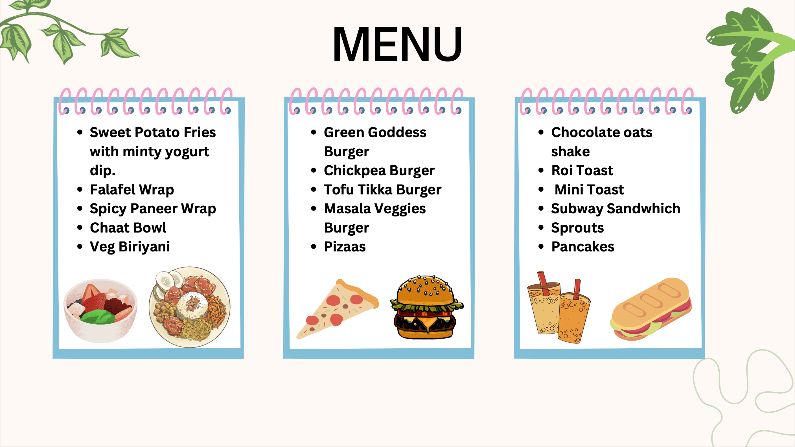

Slide 9
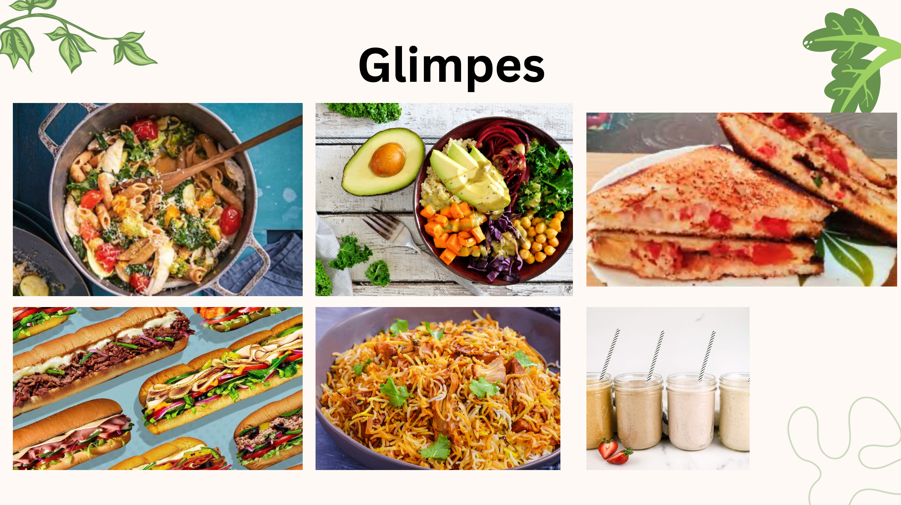

Slide 10
BUSINESS MODEL
Menu: The menu include a variety of healthy options that are low in calories, fat, and sodium.
Location: The restaurant be located in an area with high foot traffic, such as near shopping centers or offices. It also be easily accessible and have ample parking.
Ordering and payment: The restaurant offer multiple ordering and payment options, such as online ordering, mobile app ordering, and contactless payment options like Apple Pay or Google Wallet.

Slide 11
BUSINESS MODEL
Operational efficiency: The Food chain will have a streamlined ordering process to ensure that customers receive their food quickly.
Marketing and branding: The restaurant have a strong brand identity that emphasizes the health benefits of its menu.
Pricing: The pricing be competitive with other fast food chains in the area, while still allowing for a healthy profit margin.
Customer service: The restaurant have well-trained staff who are knowledgeable about the menu and can provide excellent customer service.

Slide 12
License and formalities required
GST Registration: GST registration for tax on goods and services applies . We have to make an application on the government's official website directly, with complete information, and then complete the registration on the internet.
01
FSSAI: A business that is starting in the field of food does require the FSSAI certification, and it assures the credibility and the quality of brand.
02
Trademark: If you intend to promote your brand, you should not allow anyone to imitate it. A trademark registration will guarantee name and logo are not copied by anybody else.
03

Slide 13
REVENUE MODEL
Subscription service: The restaurant offer a subscription service where customers pay a monthly fee to receive a certain number of meals per week or month. This model could be attractive to customers who want a consistent supply of healthy food options.
Catering: The restaurant offer catering services for events (50000/day), such as corporate meetings, parties, and weddings. This will be a lucrative revenue stream, as the restaurant could charge higher prices for larger orders.
Online sales: The restaurant sell its food online through a website or mobile app. Customers could order food for delivery or pickup, and the restaurant could charge a fee for the service.

Slide 14
REVENUE MODEL
Franchising: The restaurant consider franchising its concept to other entrepreneurs who want to open their own health fast food Indian restaurants. The franchisor would receive a portion of the franchisee's revenue (25%) in exchange for providing support, training, and marketing materials.
Menu pricing: The restaurant charge customers based on the prices listed on the menu. The prices could be set to reflect the cost of ingredients, preparation, and overhead costs, while also ensuring a reasonable profit margin. The restaurant could also offer promotions, discounts, or loyalty programs.

Slide 15

MARKETING STRATEGY

Slide 16
MARKETING STRATEGY
Targeted Advertisement
Influencer marketing
Loyalty program
Partnerships

Slide 17
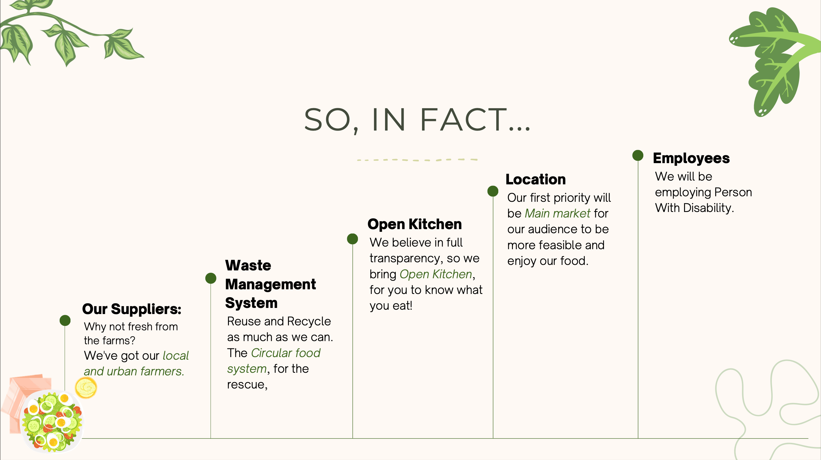
What's so Special about Soul Foods?

Slide 18
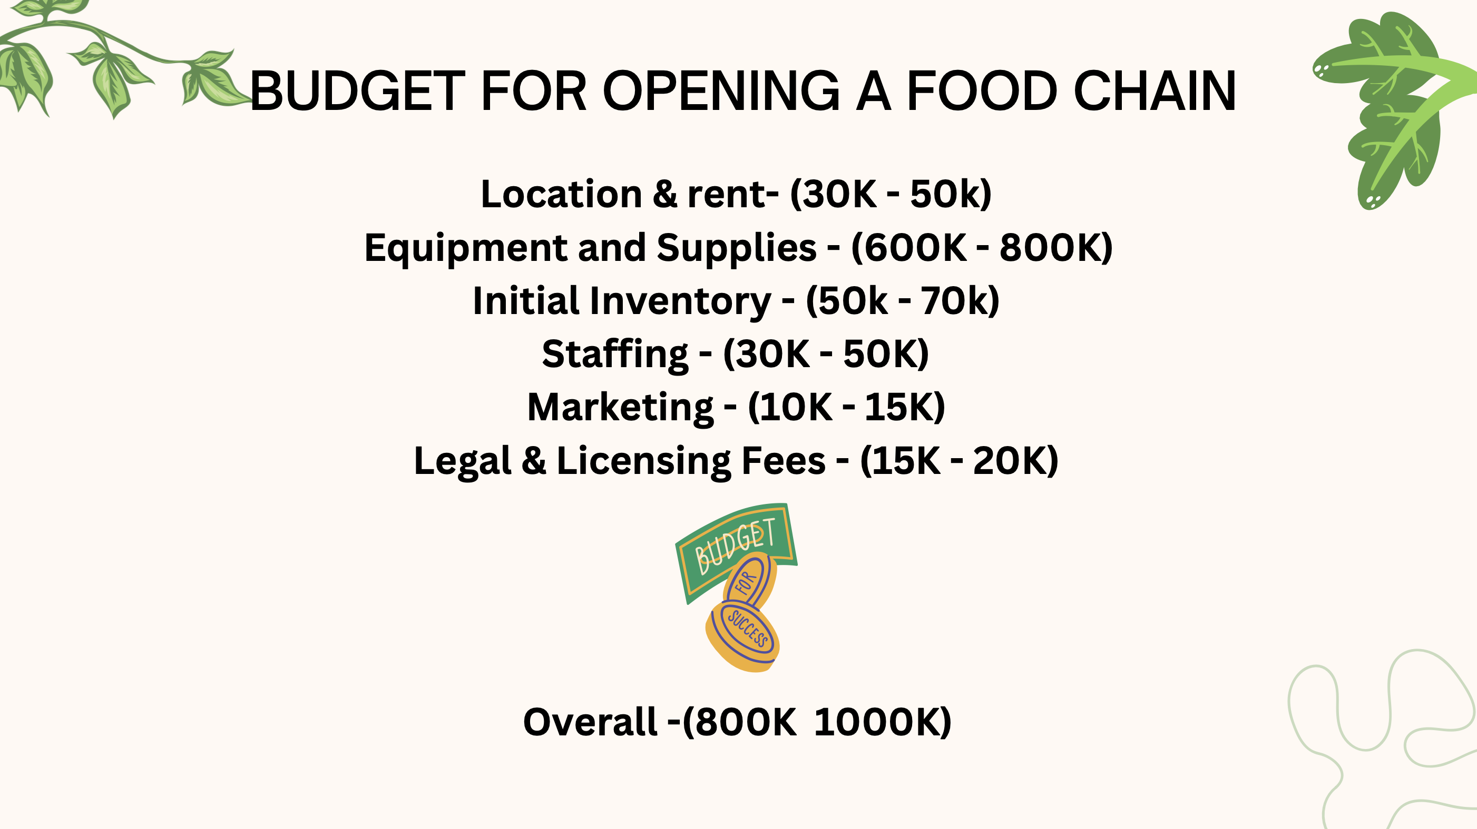

Slide 19
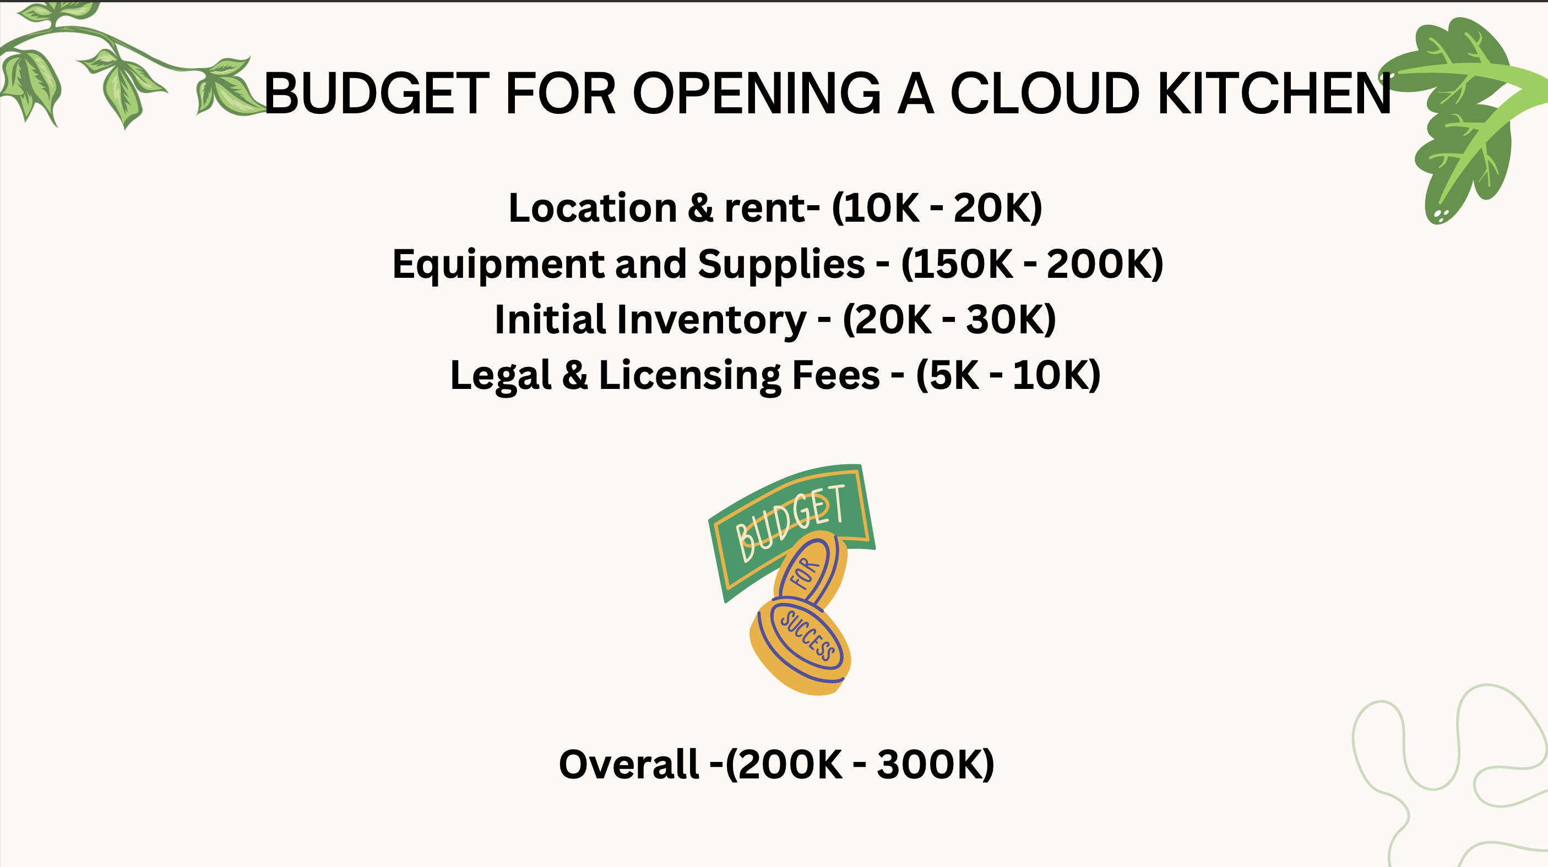

Slide 20

Executive Summary
My mission is to provide a friendly, comfortable atmosphere where the customers can receive quality food, drinks, and service at a reasonable price.
﻿﻿My food chain will offer a variety of choices to the customers. will also serve deli-style breakfast sandwiches with the freshest ingredients, muffins, croissants, cinnamon rolls, coffee cake, Oats, Upma, Chila, Dosa, Vada, Peanuts Sandwiches, Rai toast, Spicy Paneer Wrap, chat bowl, veg biriyani & many more.
Banana Shake, Oats Shake, Cappuccinos, smoothies, regular coffee, soft drinks, and tea of all sorts of drinks are also available.
﻿Soul Foods will be open from 6:00 A.M. to 11 P.M. Sunday - Saturday

Slide 21

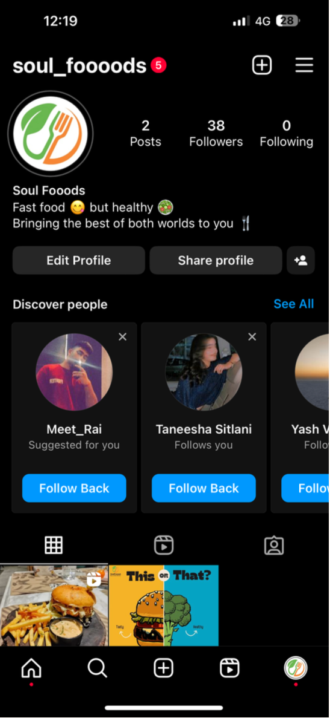

For More Info

Slide 22
Thank you

